Slide 1

School of Computing
Vel Tech Rangarajan Dr. Sagunthala R&D Institute of Science and Technology
Department of Computer Science and Engineering
10211 CS 224 / FULL S T A C K APPLICATION DEVELOPMENT (JAVA)
PROJECT REVIEW : MILESTONE PROJECT – 1
Date: 23-03-2026
Real-Time Event Synchronization Engine
SDG: SDG 9 — Industry, Innovation and Infrastructure
Presented By:
V.Venkata Siva Prasad – VTU26004 – 23UECS0585
Courses Handling Faculty:
Dr. Angeline Lydia

Slide 2
INTRODUCTION
In today's fast-growing digital world, modern software applications are built using distributed architectures where multiple independent services, devices, and platforms need to communicate and share data with each other continuously and simultaneously in real time.
As the number of connected services increases, keeping all of them synchronized with the latest data becomes a major technical challenge, because any delay, loss, or duplication of information between services can lead to serious errors, inconsistencies, and poor user experience across the entire system.
A Real Time Event Synchronization Engine is a software system designed to solve this problem by acting as a centralized hub that captures events from multiple producers, processes and validates them, and delivers them instantly to all subscribed consumers with guaranteed ordering and reliability.
5 • This project aims to build a high-performance event synchronization engine using Java Spring Boot as the backend framework, Apache Kafka as the message broker for reliable fan-out delivery, PostgreSQL for permanent event storage, and Redis for fast deduplication and caching.
The system supports multiple delivery protocols including WebSocket for real-time push notifications, REST long-polling for batch consumers, and webhook callbacks for external service integrations, making it flexible and suitable for a wide range of use cases.
It is applicable across many real-world domains such as e-commerce order tracking, financial transaction processing, healthcare data streaming, IoT sensor monitoring, and social media notification systems where real-time data synchronization is critical.
The project also includes a live monitoring dashboard that displays real-time metrics such as throughput, latency, consumer lag, and error rate, giving administrators complete visibility and control over the entire event pipeline at all times.
Overall, this project provides a scalable, reliable, and developer-friendly solution that addresses the core challenges of real-time event synchronization in modern distributed systems and delivers a robust foundation for building event-driven applications.
1
2
3
4
6
7
8
9

Slide 3
PROBLEM STATEMENT
In modern distributed systems, multiple services such as web applications, mobile apps, IoT sensors, and microservices need to share and synchronize data with each other in real time, but existing systems lack a unified and reliable mechanism to propagate events consistently across all connected services.
Microservices often maintain their own local state without any proper synchronization with other services, leading to data inconsistencies, stale information, and conflicting records across the system that are difficult to detect and resolve manually.
Event loss or duplication during transmission is a critical problem in high-throughput environments, as there is no standardized protocol for guaranteed message ordering, deduplication, or failure recovery in most real-time event pipelines currently in use.
The absence of a centralized event routing and fan-out mechanism forces each service to implement its own messaging logic independently, resulting in tightly coupled architectures that are hard to scale, maintain, and extend over time.
Monitoring and tracing event flows across distributed nodes is extremely complex and error-prone without a dedicated system, making it nearly impossible to identify the root cause of delays, failures, or data drift in production environments.
Hence, there is a strong need for a robust, scalable, and fault-tolerant Real Time Event Synchronization Engine that provides guaranteed event delivery, ordered sequencing, consumer replay, and live monitoring to solve all these challenges in a single unified platform.
1
2
3
4
5
6
7
8
9

Slide 4
OBJECTIVE(S)
1
Objective 1:
To design and develop a high-performance Real Time Event Synchronization Engine that ensures reliable, low-latency event propagation across multiple distributed services and consumers using Apache Kafka as the central message broker.
2
3
4
Objective 2:
To implement a secure and scalable event ingestion pipeline with JWT-based authentication, JSON schema validation, rate limiting, and sequence ID assignment to guarantee the integrity and ordering of every published event.
5
6
7
8
9

Slide 5
PROPOSED SYSTEM
1
The proposed system is a web-based Real Time Event Synchronization Engine that acts as a centralized platform for capturing, processing, and delivering events across multiple distributed services instantly.
2
3
Producers such as web applications, mobile apps, IoT sensors, and microservices publish events to the engine through a secure REST API or WebSocket connection with JWT authentication.
4
The engine validates each incoming event, assigns a unique sequence ID and timestamp, and routes it to the correct topic partition in the Apache Kafka message broker for reliable fan-out delivery.
5
Subscribed consumers receive the synchronized events in real time through WebSocket push, REST long-polling, or webhook callbacks with guaranteed delivery and automatic retry on failure.
7
8
Every event is permanently stored in a PostgreSQL event log with full payload and metadata, enabling consumers to replay missed events from any sequence offset for fault recovery and audit purposes.
9
A live monitoring dashboard displays real-time metrics such as throughput, latency, consumer lag, and error rate using interactive charts, allowing administrators to track system health and control the engine at any time.

Slide 6
PROPOSED SYSTEM ARCHITECTURE
1
Producers (web apps, mobile, IoT, microservices) send events to the engine via REST or WebSocket.
2
The API Gateway validates every incoming event — checking authentication, rate limits, and JSON schema — before it enters the system.
4
The Event Engine Core sequences, deduplicates, and routes each event to the correct Kafka/RabbitMQ topic partition.
5
The Message Broker fans out each event to all subscribed consumers simultaneously via WebSocket push, REST polling, or webhooks.
6
7
Every event is persisted to a PostgreSQL event log for replay and audit, while Redis handles caching and deduplication.
8
9

Slide 7
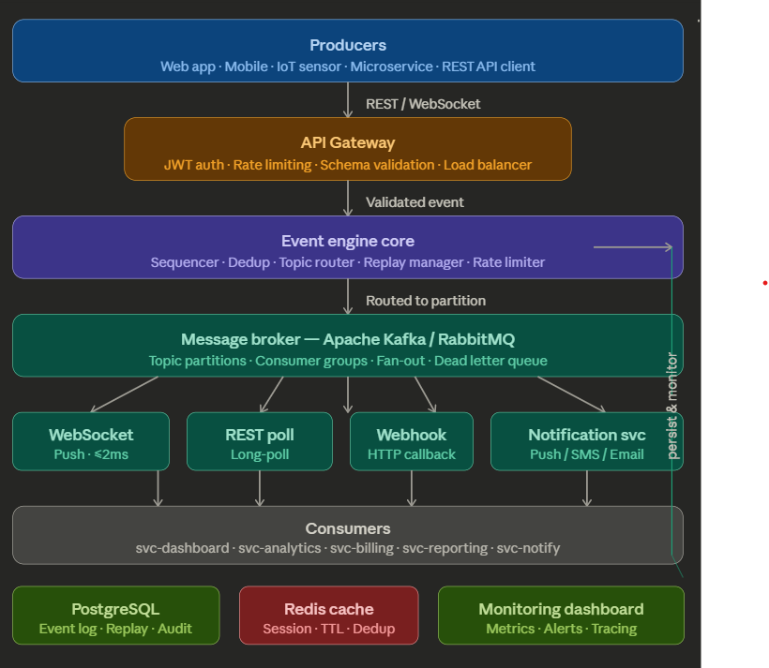
PROPOSED SYSTEM ARCHITECTURE

Slide 8
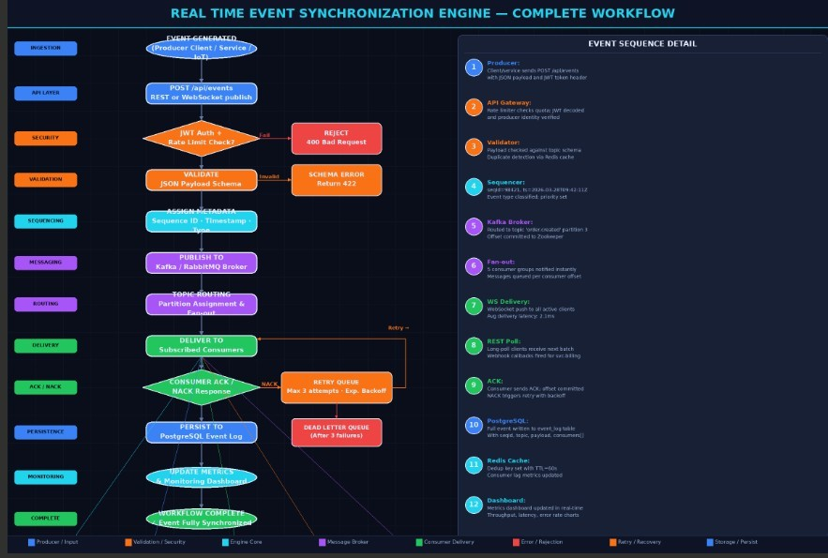
WORKFLOW
1
2
3
4
5
6
7
8
9

Slide 9
TECHNOLOGIES USED
Frontend Technologies
Backend Technologies
1
React.js — Single Page Application UI
WebSocket Client (STOMP /
SockJS) — real-time event streaming to browser
TailwindCSS — styling and layout
Chart.js — live throughput and latency charts
Java 17 (Spring Boot) — main application framework
Spring Web MVC — REST API endpoints
Spring WebSocket (STOMP) — WebSocket server for live event push
Spring Security + JWT — authentication and authorization
Maven — build and dependency management
2
3
4
5
6
Database & Cache
8
9
PostgreSQL — ordered event log, replay support, audit trail
Redis — deduplication cache, session management, TTL-based keys

Slide 10
MODULE DESCRIPTION
1
Module 1: Event Producer API
Handles all incoming event requests from producers like web apps, mobile apps, IoT sensors, and microservices through REST and WebSocket endpoints. It verifies JWT authentication, applies rate limiting, and validates the JSON payload schema before allowing the event into the system.
2
3
4
Module 2: Event Routing Engine
Acts as the core processing brain that assigns a unique sequence ID, timestamp, and priority to each validated event. It then routes the event to the correct Kafka topic partition using predefined rules and eliminates duplicate events using Redis cache.
5
6
7
Module 3: Consumer Subscription Manager
Manages all registered consumers that subscribe to receive events through WebSocket, REST Poll, or Webhook protocols. It tracks each consumer's subscription topics, monitors message lag, and handles reconnection with offset-based replay.
8
9
Module 4: Message Broker Integration
Connects the routing engine to Apache Kafka or RabbitMQ and manages topic creation, partition handling, and consumer group coordination. It fans out every event simultaneously to all subscribed consumer groups and sends failed events to the Dead Letter Queue after maximum retries. so no event is missed.

Slide 11
MODULE DESCRIPTION
Module 5: Event Log and Persistence
Stores every event permanently in a PostgreSQL append-only log table with full details including payload, sequence ID, topic, producer, timestamp, and delivery status. This log powers the replay feature, allowing any consumer to recover missed events by requesting events from a specific sequence offset.
Module 6: Real-Time Monitoring Dashboard
Provides a live web dashboard that displays real-time metrics such as throughput, latency, consumer lag, error rate, and topic statistics using Chart.js graphs. It automatically raises alerts when consumer lag or error rate crosses acceptable thresholds and allows the admin to pause or resume the engine.

Slide 12
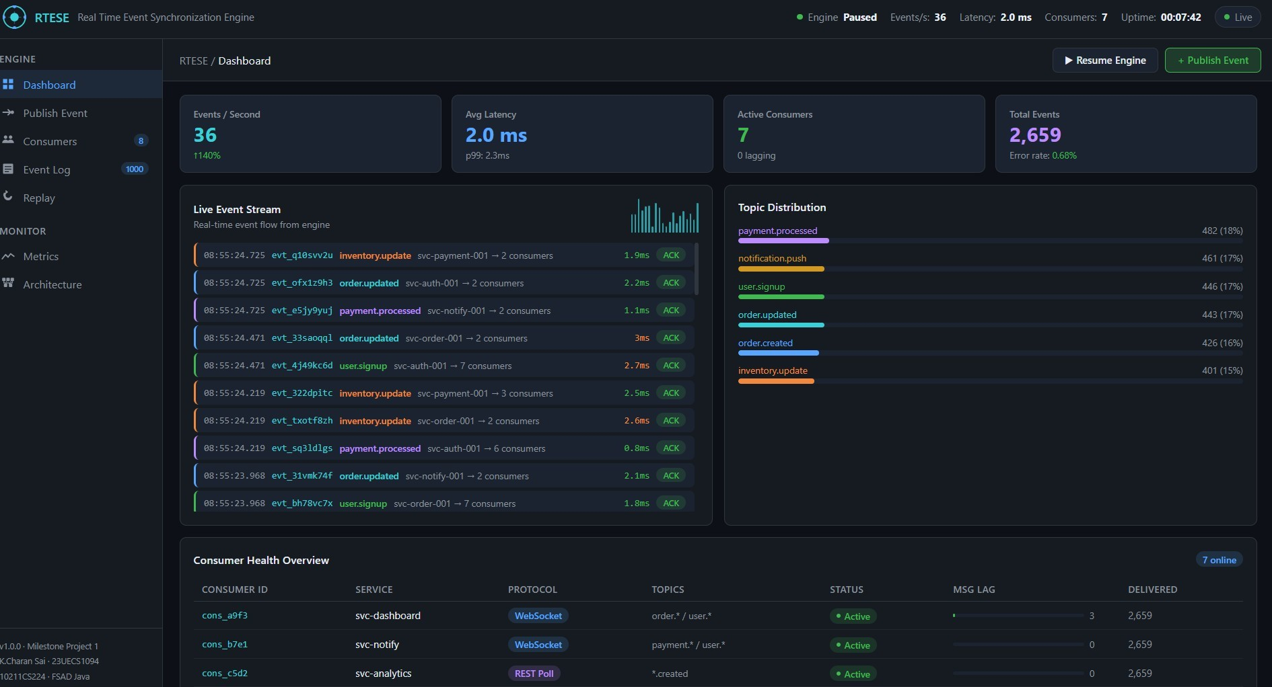
IMPLEMENTATION SCREENSHOTS
1
2
3
4
5
6
7
8
9

Slide 13
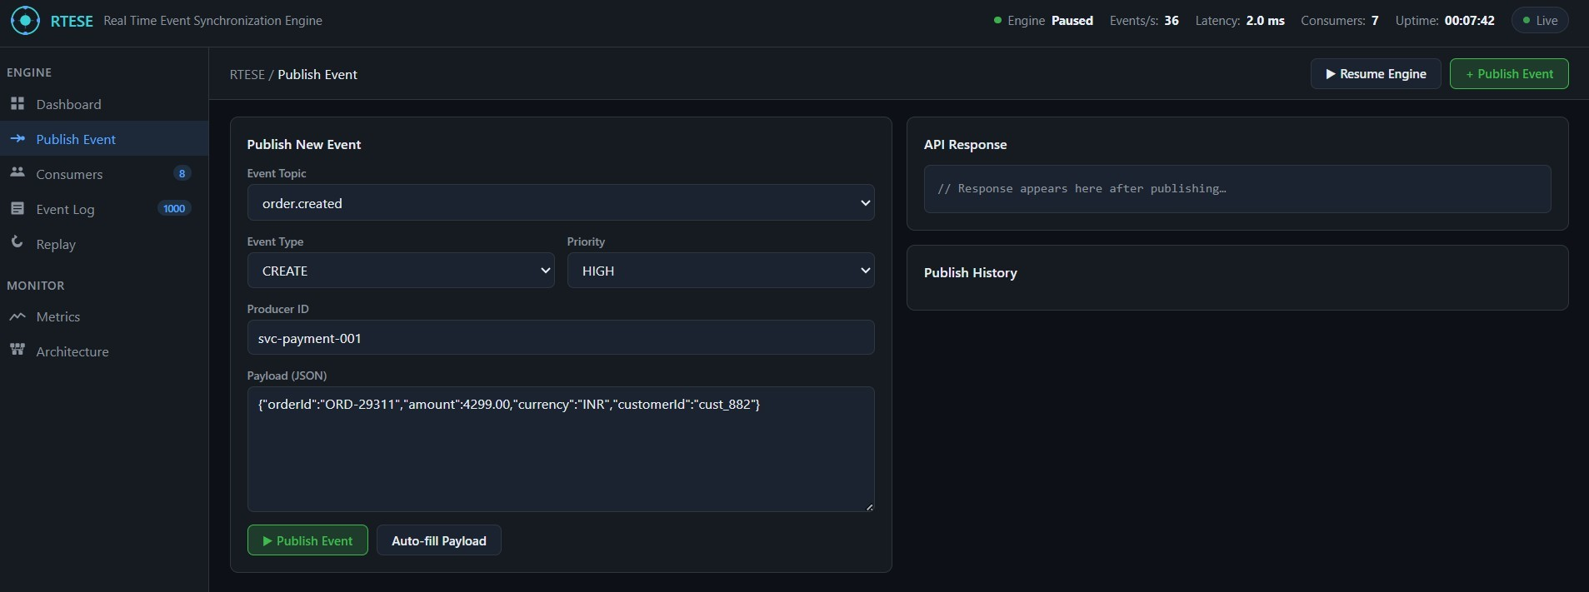
IMPLEMENTATION SCREENSHOTS
1
2
3
4
5
6
7
8(A)
9

Slide 14
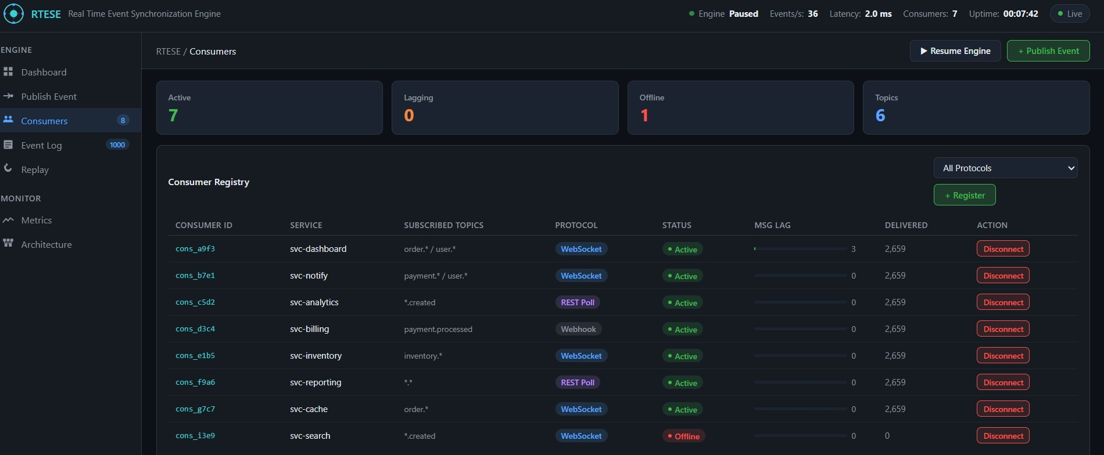
IMPLEMENTATION SCREENSHOTS
1
2
3
4
5
6
7
8(B)
9

Slide 15
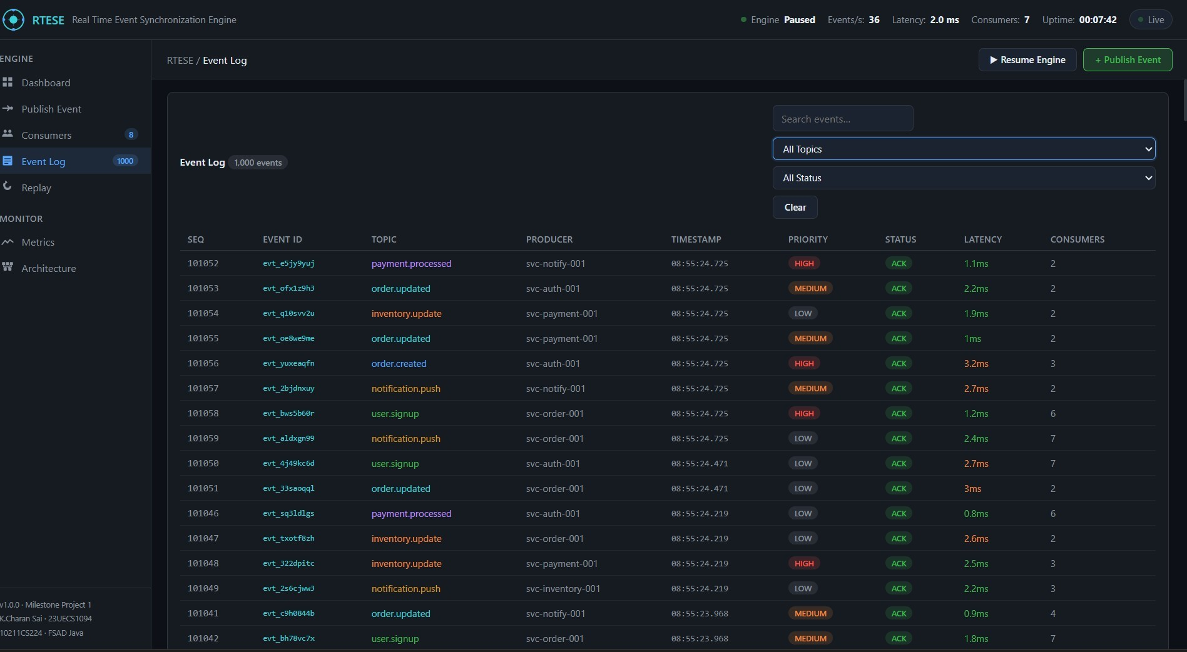
IMPLEMENTATION SCREENSHOTS

Slide 16
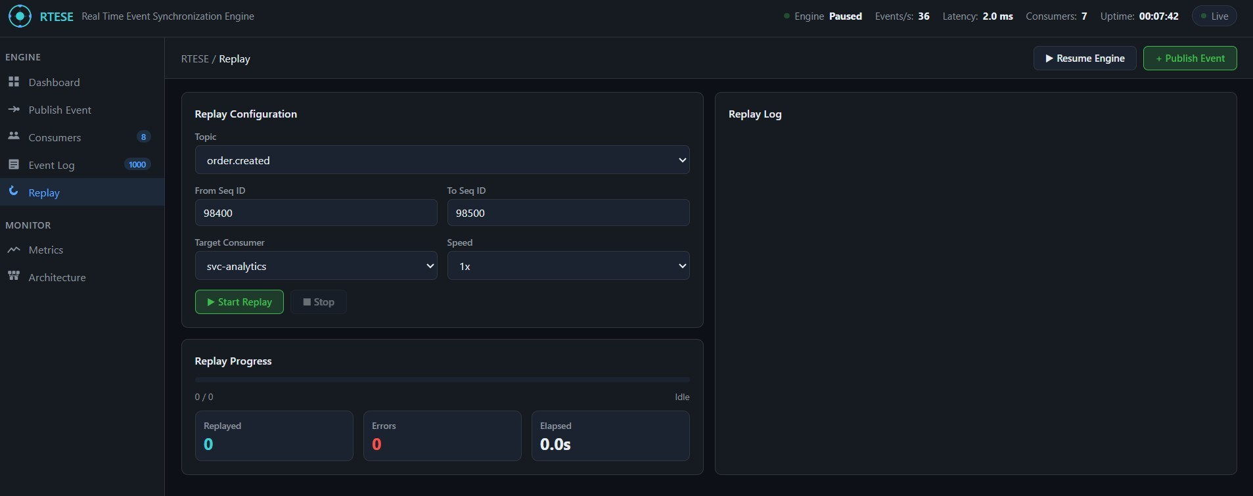
IMPLEMENTATION SCREENSHOTS

Slide 17
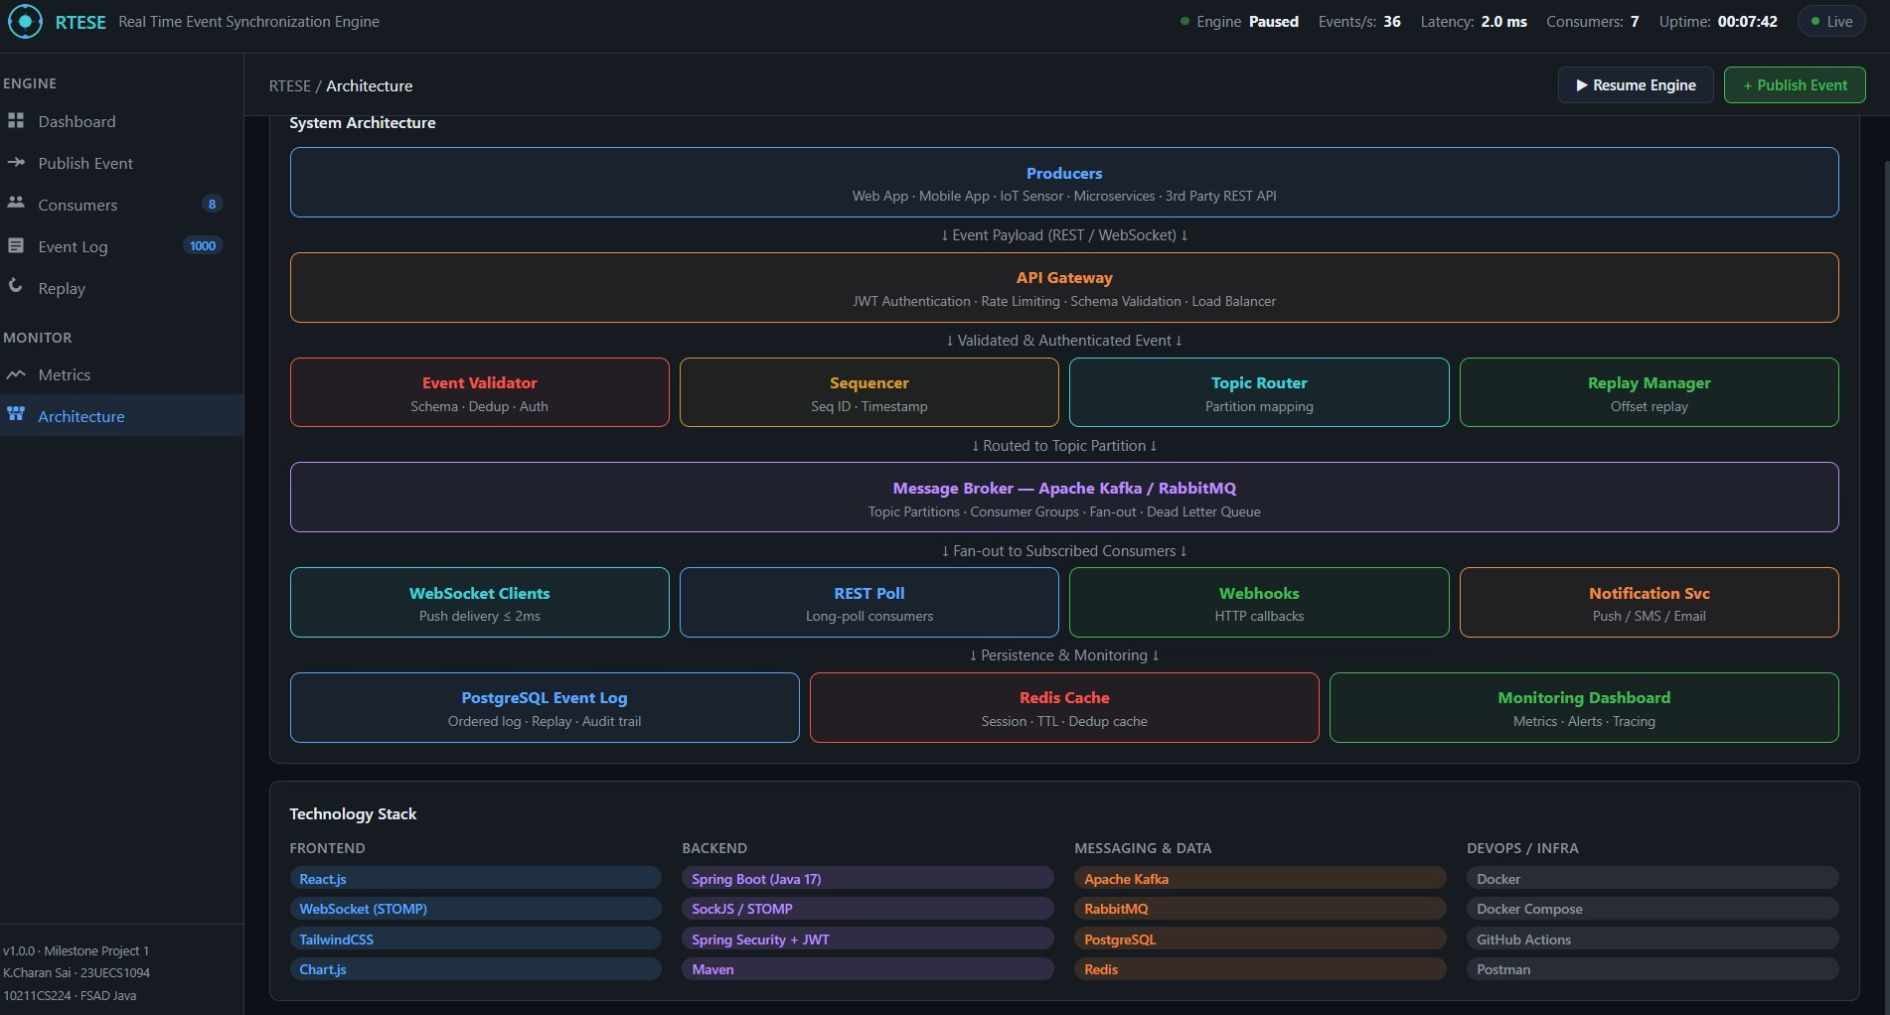
IMPLEMENTATION SCREENSHOTS

Slide 18
ADVANTAGES & LIMITATIONS
1
ADVANTAGES:
2
The system provides real-time event delivery with an average latency of under 2ms, ensuring all connected consumers receive synchronized data instantly without any manual intervention or polling delays.
It supports horizontal scalability through Apache Kafka's partitioned topic architecture, allowing the engine to handle thousands of events per second by simply adding more broker nodes and consumer instances.
The built-in fault tolerance mechanism with retry queues, exponential backoff, and Dead Letter Queue ensures no event is permanently lost even when a consumer is temporarily offline or a network failure occurs.
The centralized event log in PostgreSQL with full replay support allows any consumer to recover missed events from any point in time, making the system highly reliable for audit, debugging, and
3
4
5
6
7
8
disaster recovery purposes.
9

Slide 19
ADVANTAGES & LIMITATIONS
LIMITATIONS:
The system requires a stable and high-bandwidth network infrastructure to maintain low-latency event delivery, and any network instability between the broker, producers, and consumers can cause increased lag and delivery failures.
Setting up and maintaining multiple distributed components such as Apache Kafka, Zookeeper, Redis, and PostgreSQL together increases the operational complexity, making it difficult to deploy and manage without proper DevOps expertise.
A single-broker setup without replication creates a single point of failure, meaning if the Kafka broker goes down, the entire event pipeline is disrupted until the broker is restarted or failover is configured.
Debugging and tracing event flows across multiple distributed services is challenging, as identifying the root cause of a delayed or lost event requires checking logs across the producer, broker, routing engine, and consumer layers simultaneously.

Slide 20
Thank you

